Slide 1
Networking
UBMS Stem Experience: Jurassic Park
Notes:
Video on device differences: https://www.youtube.com/watch?v=Vc16CCAAz7Q

Slide 2
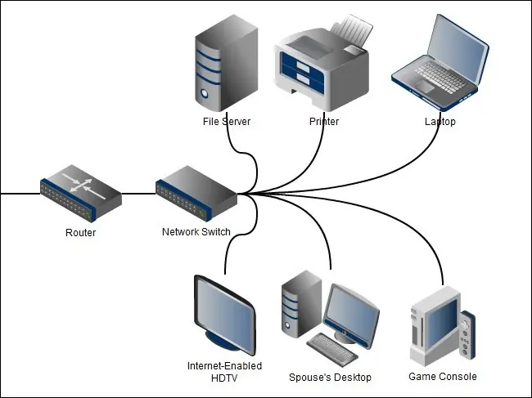
What is a network?

Slide 3

Island Design

Slide 4
Island Design

Slide 5
Island Network

Slide 6
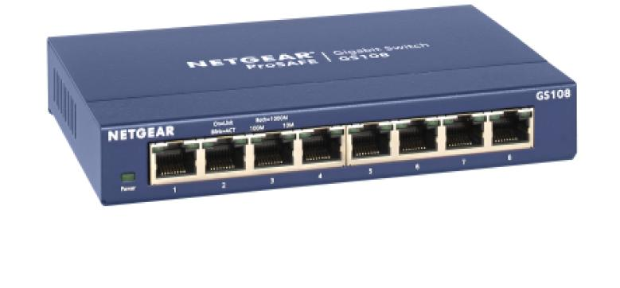
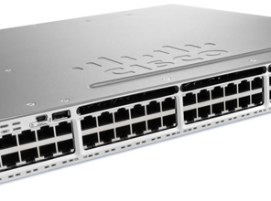
Network Switches

Slide 7
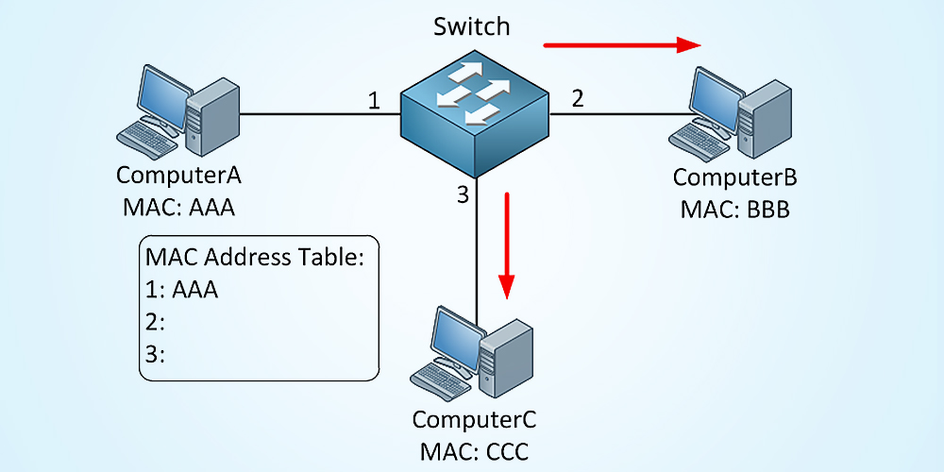
Switches: MAC Address Tables

Slide 8
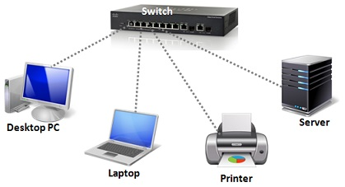
Local Area Network

Slide 9
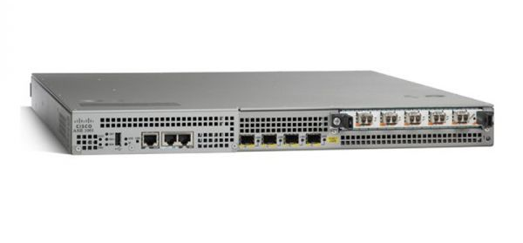
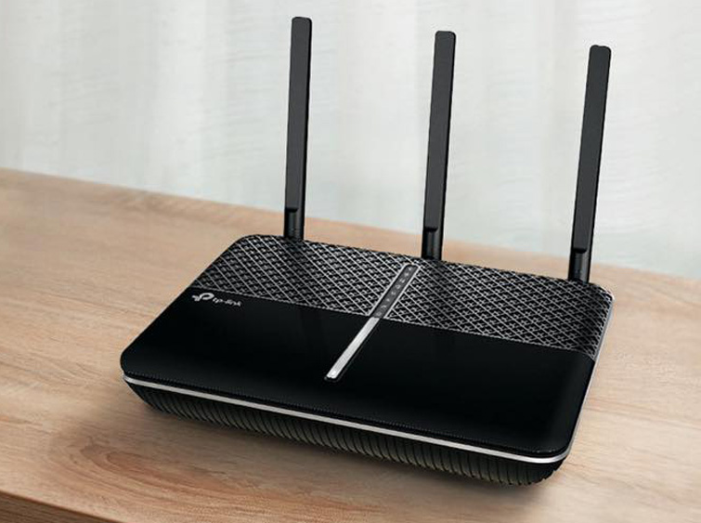
Network Routers

Slide 10
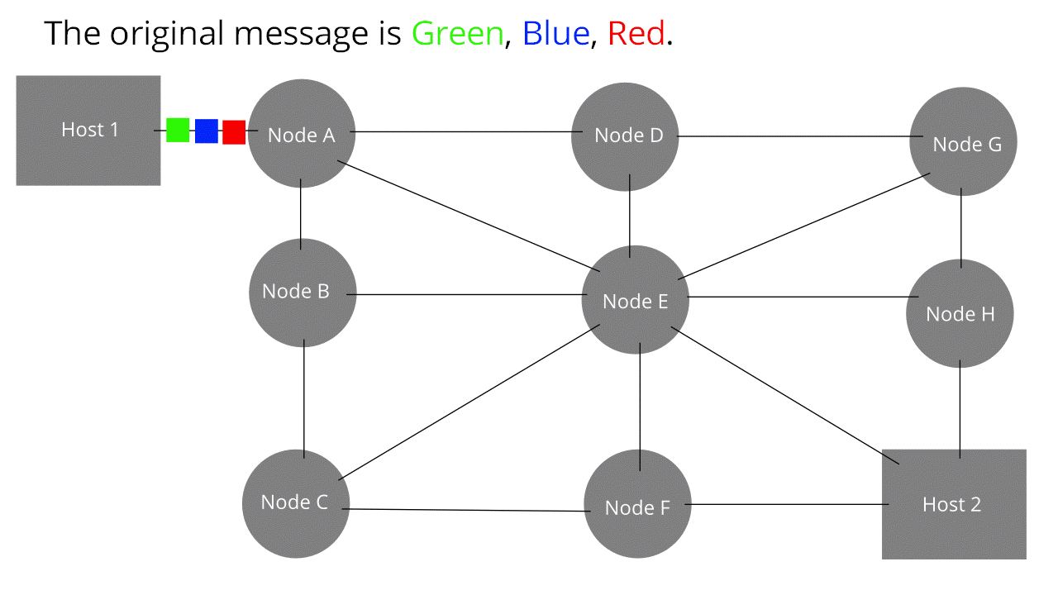
Routing Traffic

Slide 11
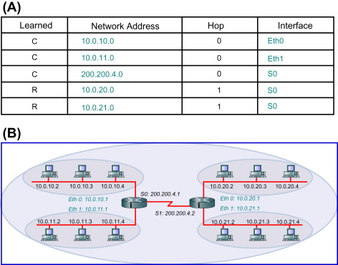
Router & Routing Tables

Slide 12
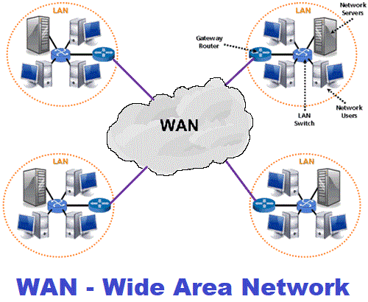
Wide Area Network

Slide 13
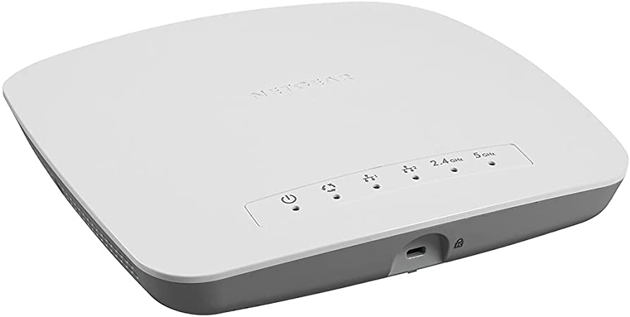
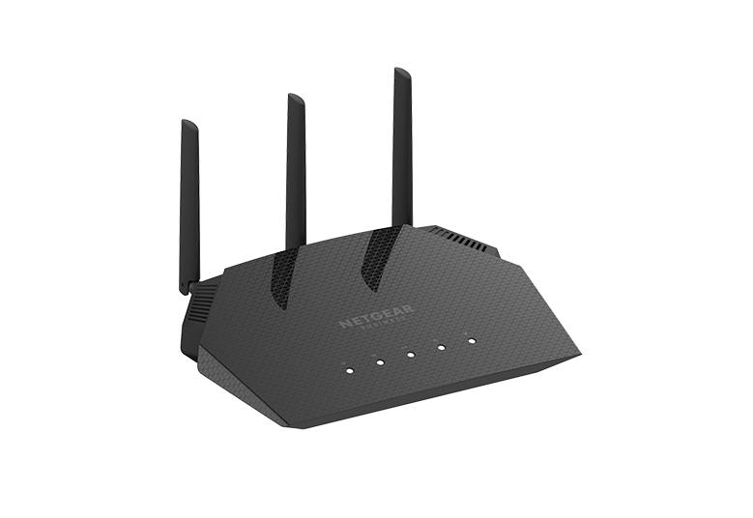
Wireless Access Points

Slide 14
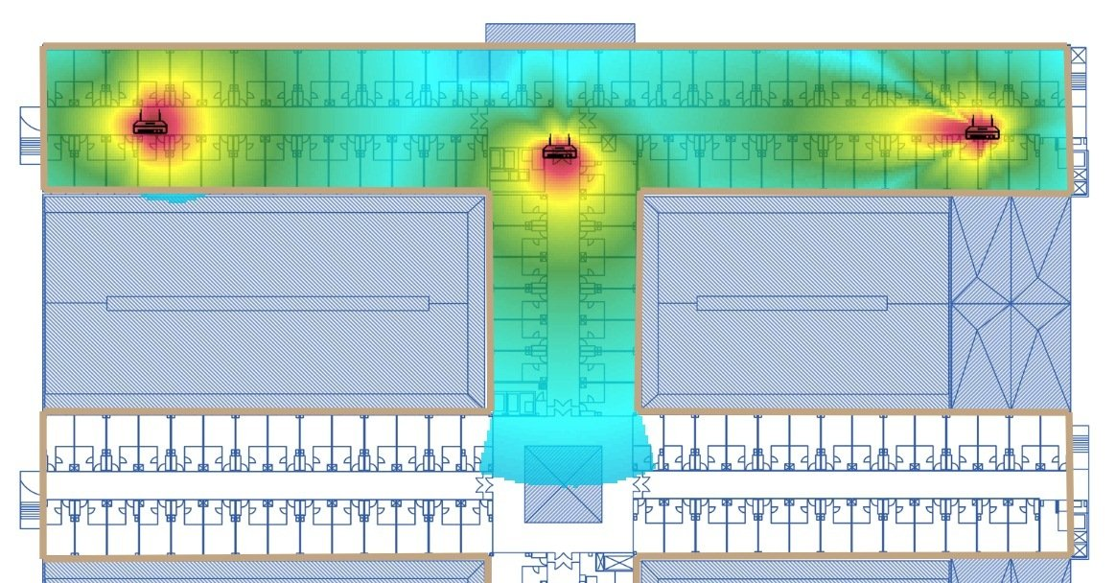
Wireless Coverage

Slide 15
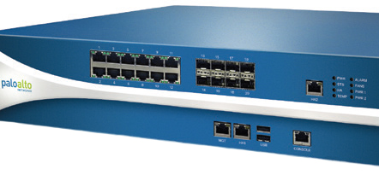
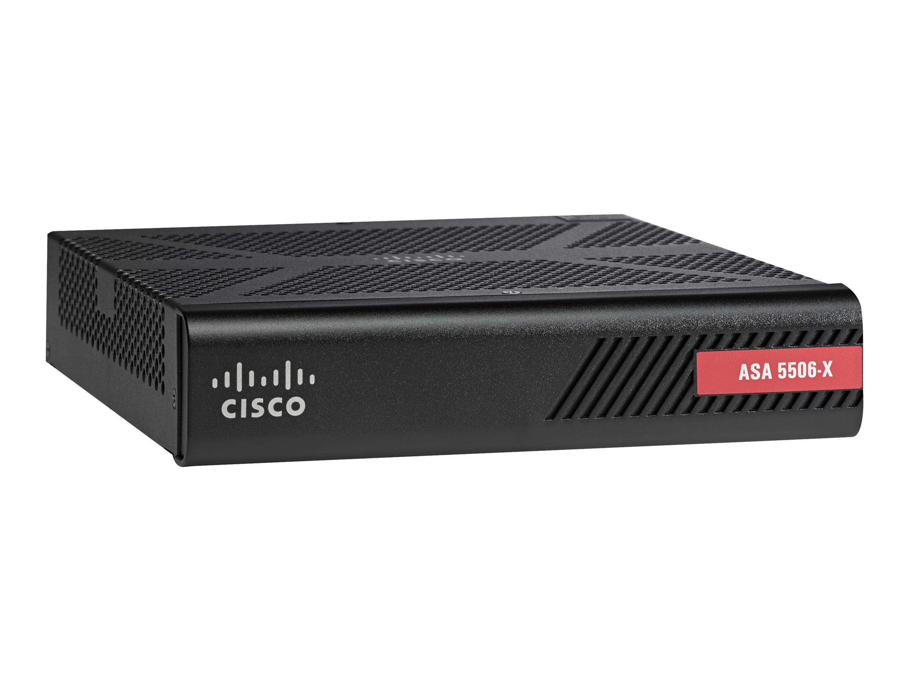
Network Firewalls

Slide 16
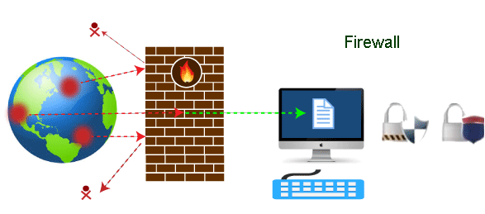
Firewall Defenses

